Slide 1
Economics of digital markets
Patrick waelbroeck

Slide 2
Lecture 9
Strategies with digital copies

Slide 3
How to create value in the presence of digital copies?
Title: Presentation
Subtitle field
Versioning
Indirect appropriation
Network externalities
Informational externalities

Slide 4
versioning
Title: Presentation
Subtitle field
Copy = lower quality version
Some customers do not purchase anymore (= competition)
How to respond?
Introduce lower quality version at lower price
Example: student version of software
Introduce a free version financed by ads
Fighting free with free
Market expansion

Slide 5
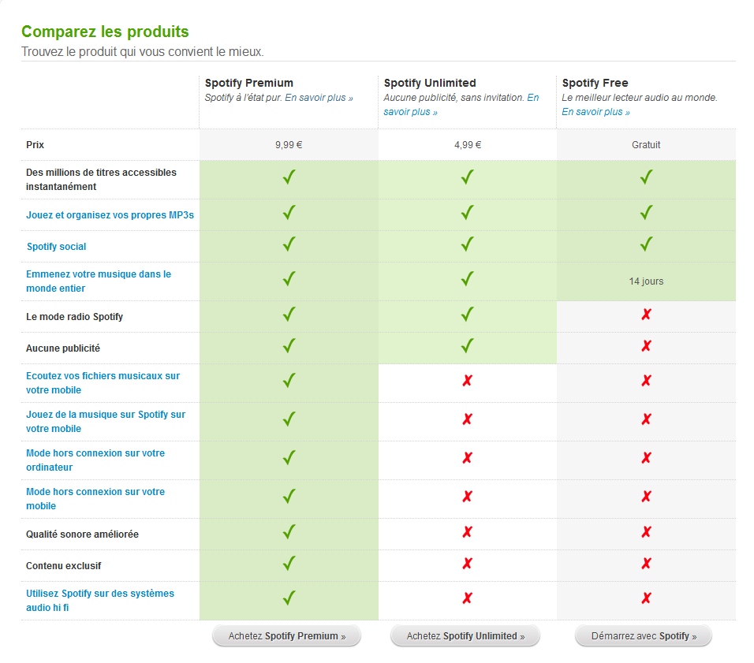
freemium
Title: Presentation
Subtitle field

Slide 6
Indirect appropriation
Title: Presentation
Subtitle field
Possible to monitor number of copies
Example: photocopies
Increase price of original product
Consequences:
Versioning: Individual subscription <> libraries
books < Academic journals
How to implement?
Enforce monitoring of copies
Example: Business Software Alliance, site licences with internet activation

Slide 7
Indirect appropriation: Other strategies
Title: Presentation
Subtitle field
Increase price of complementary products
Examples: Concerts, Ipods
Create/increase taxes
iPod
Portable hard drives
CD-R
DVD+R/W
Implemented in many European countries

Slide 8
Leverage on network effects
Title: Presentation
Subtitle field
Strategy: use piracy to build a critical mass of users
Suppose two groups of consumers: low- and high-value
Without piracy: sell to high-value consumers
With piracy: more users increases the value, which increases price and profit from high-value consumers
Example: free online multiplayers video games, F2P, micro-transactions

Slide 9
Network externalities (cont.)
Title: Presentation
Subtitle field
Strategy: allow piracy to build a critical mass of users
Example: Microsoft in China
Early phase: Do not legally fight illegal copies
Later: lobby for reinforcement of intellectual property

Slide 10
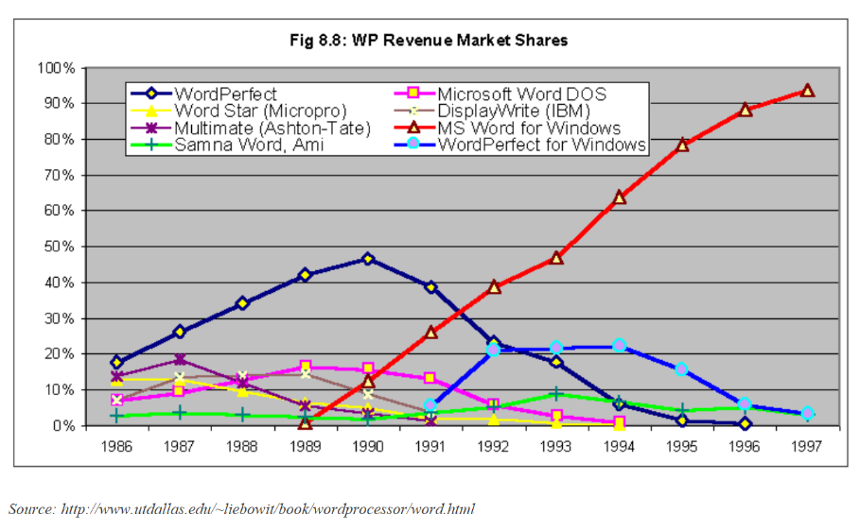
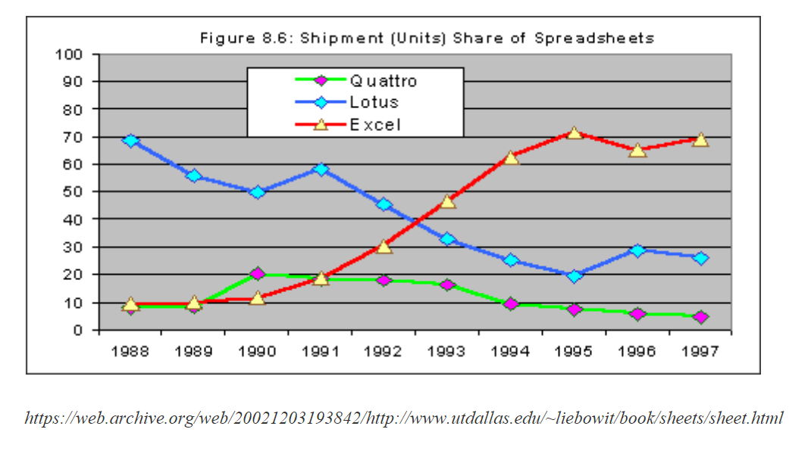
Network externalities (cont.)
Title: Presentation
Subtitle field

Slide 11
Information externalities
Title: Presentation
Subtitle field
Example: Music as an experience good
Consumers need information on new releases
Solution 1: Information-push (TV, radio, magasines)
Cost is supported by record companies
Solution 2: Information-pull
Ex: free listening in record stores
Generalization: Internet, P2P networks
Cost is supported by consumers

Slide 12
Digital copies and information
Title: Presentation
Subtitle field
What if copies provide information?
Competition effect: reduce willingness to pay for music
vs. Matching effect of digital copies: increase WTP for music
Suppose large number of albums and no information: pick album at random; sometimes enjoy, sometimes do not enjoy; on average, low value if only one album matches your taste
Suppose you can download as much as you want for small cost: you find out which album you like best; higher willingness to pay for albums
Solution : freemium and F2P

Slide 13
Title
Subtitle

